Slide 1
Graph Algorithms

Slide 2
Graph Algorithms
Graphs are mathematical structures that represent pairwise relationships between objects. A graph is a flow structure that represents the relationship between various objects.

Slide 3
Two Basic Components of Graphs
Nodes: These are the most important components in any graph. Nodes are entities whose relationships are expressed using edges. If a graph comprises 2 nodes A and B and an undirected edge between them, then it expresses a bi-directional relationship between the nodes and edge.

Slide 4
Two Basic Components of Graphs
Edges: Edges are the components that are used to represent the relationships between various nodes in a graph. An edge between two nodes expresses a one-way or two-way relationship between the nodes.

Slide 5
Types of Nodes
Root node: The root node is the ancestor of all other nodes in a graph. It does not have any ancestor. Each graph consists of exactly one root node. Generally, you must start traversing a graph from the root node.

Slide 6
Types of Nodes
Leaf nodes: In a graph, leaf nodes represent the nodes that do not have any successors. These nodes only have ancestor nodes. They can have any number of incoming edges but they will not have any outgoing edges.

Slide 7
Types of Graphs
Undirected Graph
Directed Graph
Weighted Graph
Cyclic Graph
Acyclic Graph

Slide 8
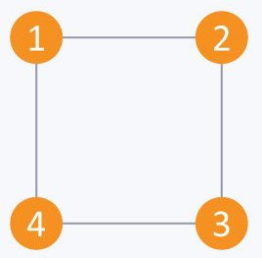
Types of Graphs
Undirected: An undirected graph is a graph in which all the edges are bi-directional.
the edges do
not point in any
specific direction.

Slide 9
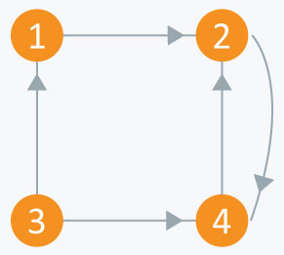
Types of Graphs
Directed: A directed graph is a graph in which all the edges are uni-directional.
the edges point in a single direction.

Slide 10
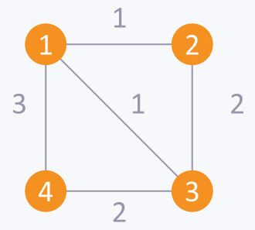
Types of Graphs
Weighted: In a weighted graph, each edge is assigned a weight or cost.

Slide 11
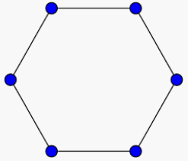
Types of Graphs
Cyclic: A graph is cyclic if the graph comprises a path that starts from a vertex and ends at the same vertex. That path is called a cycle.
An acyclic graph is a graph that has no cycle.

Slide 12
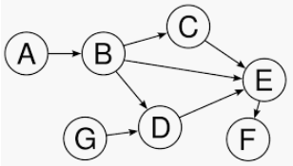
Types of Graphs
Acyclic: An acyclic graph is a graph that has no cycle.

Slide 13
TREE
A tree is an undirected graph in which any two vertices are connected by only one path. A tree is an acyclic graph and has N - 1 edges where N is the number of vertices. Each node in a graph may have one or multiple parent nodes. However, in a tree, each node (except the root node) comprises exactly one parent node.
Notes:
Note: A root node has no parent.
A tree cannot contain any cycles or self loops, however, the same does not apply to graphs.

Slide 14
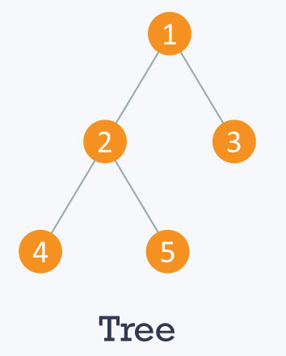
TREE
Notes:
Note: A root node has no parent.
A tree cannot contain any cycles or self loops, however, the same does not apply to graphs.

Slide 15
GRAPH TRAVERSALS
Graph traversal means visiting every vertex and edge exactly once in a well-defined order. While using certain graph algorithms, you must ensure that each vertex of the graph is visited exactly once. The order in which the vertices are visited are important and may depend upon the algorithm or question that you are solving.
Notes:
Note: A root node has no parent.
A tree cannot contain any cycles or self loops, however, the same does not apply to graphs.

Slide 16
1. DEPTH FIRST SEARCH (DFS)
Whenever a vertex v is visited during the search, DFS will recursively visit all of v 's unvisited neighbors. Equivalently, DFS will add all edges leading out of v to a stack. The next vertex to be visited is determined by popping the stack and following that edge.
Notes:
Note: A root node has no parent.
A tree cannot contain any cycles or self loops, however, the same does not apply to graphs.

Slide 17
The effect is to follow one branch through the graph to its conclusion, then it will back up and follow another branch, and so on. The DFS process can be used to define a depth-first search tree.
Notes:
Note: A root node has no parent.
A tree cannot contain any cycles or self loops, however, the same does not apply to graphs.

Slide 18
This tree is composed of the edges that were followed to any new (unvisited) vertex during the traversal, and leaves out the edges that lead to already visited vertices. DFS can be applied to directed or undirected graphs.
Notes:
Note: A root node has no parent.
A tree cannot contain any cycles or self loops, however, the same does not apply to graphs.

Slide 19
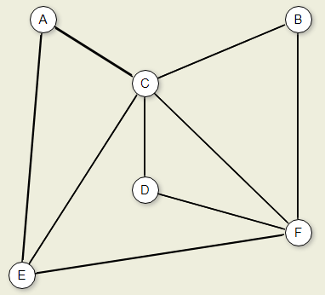
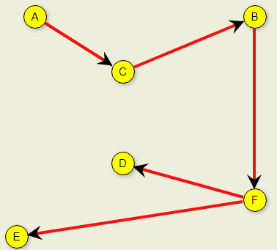
(DFS) Example
Notes:
A C B F D E

Slide 20
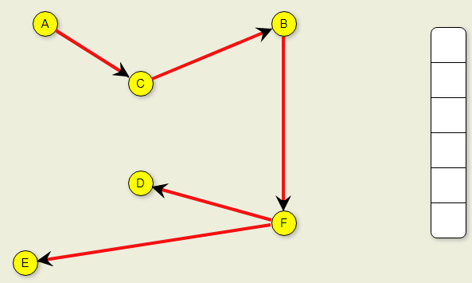
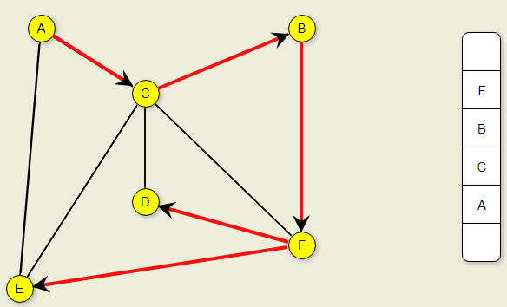
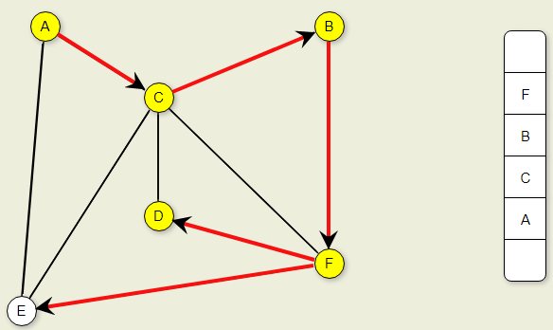
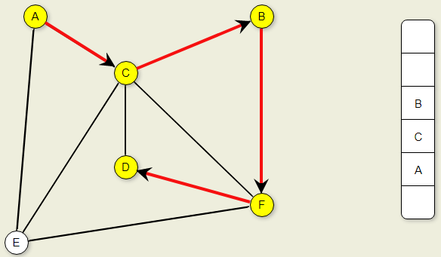
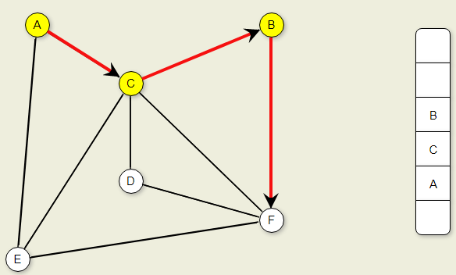
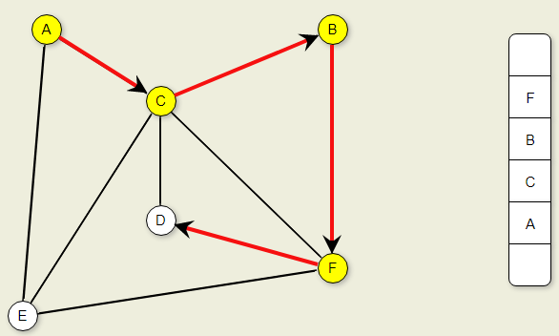
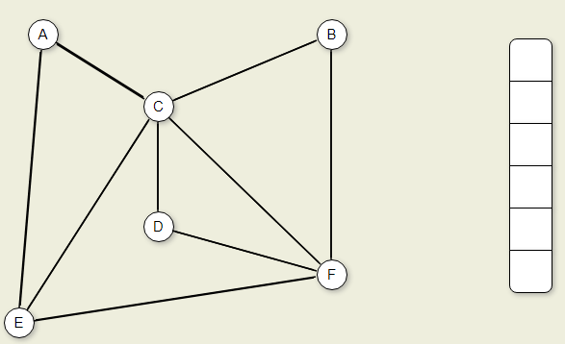
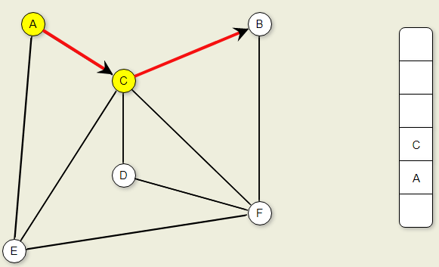
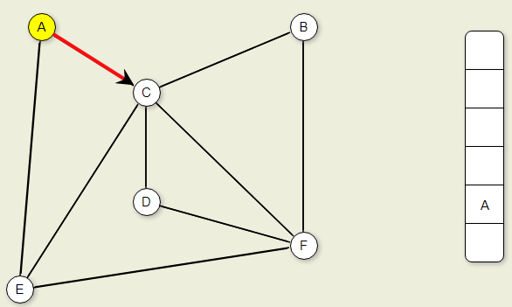





(DFS) Example
Notes:
Note: A root node has no parent.
A tree cannot contain any cycles or self loops, however, the same does not apply to graphs.

Slide 21
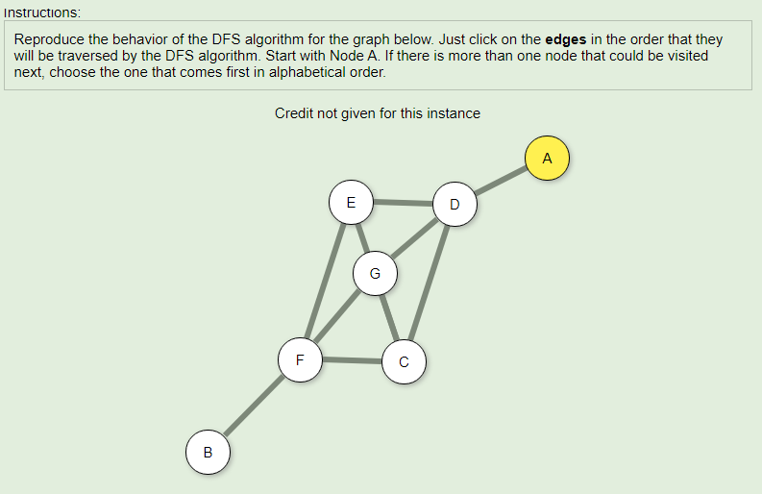
Activity
1.
Notes:
DFS
A D C E F B G

Slide 22
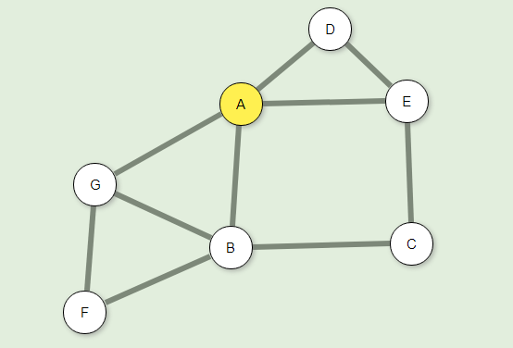
2.
Notes:
DFS
A B C E D F G

Slide 23
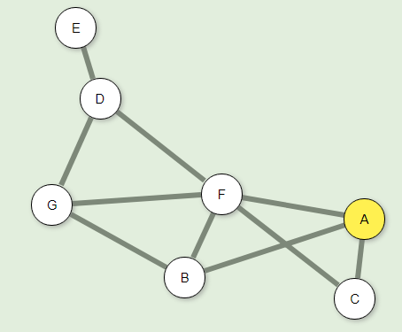
3.
Notes:
DFS
A B F C D E G

Slide 24
2. BREADTH FIRST SEARCH (BFS)
BFS examines all vertices connected to the start vertex before visiting vertices further away. BFS is implemented similarly to DFS, except that a queue replaces the recursion stack.

Slide 25
Note that if the graph is a tree and the start vertex is at the root, BFS is equivalent to visiting vertices level by level from top to bottom.
This visualization shows a graph and the result of performing a BFS on it, resulting in a breadth-first search tree.

Slide 26
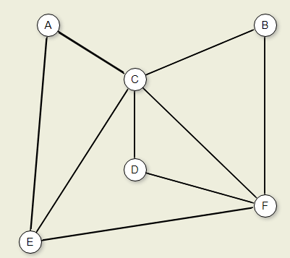
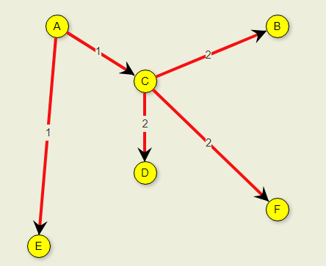
(BFS) Example

Slide 27
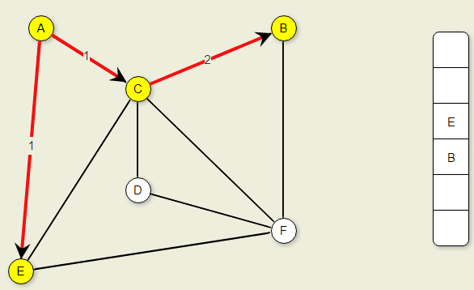
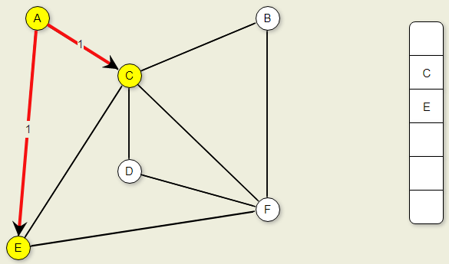
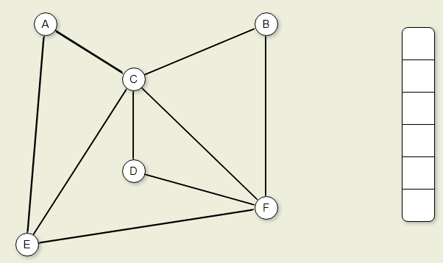
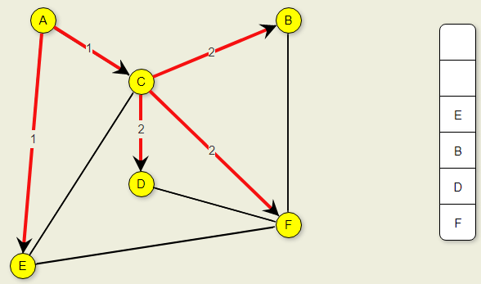
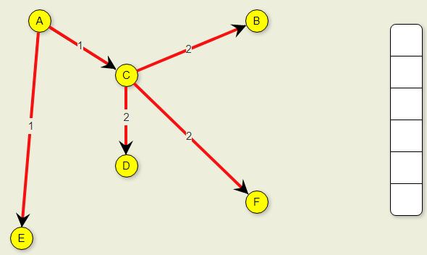
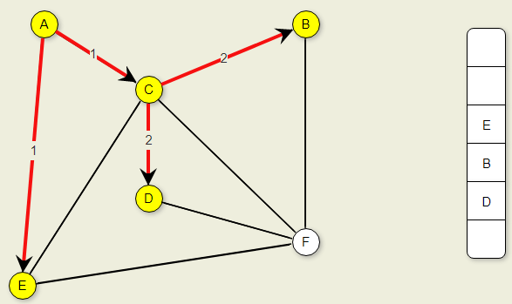
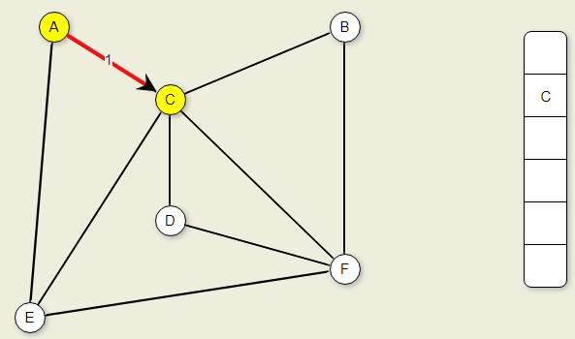
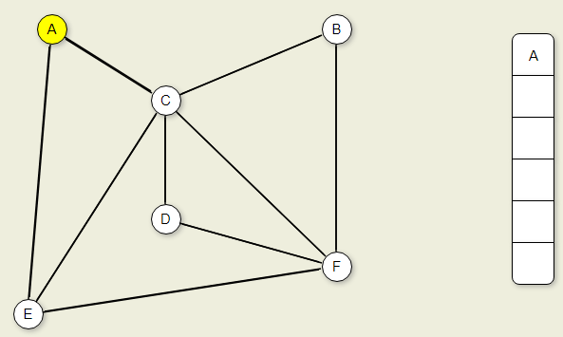



(BFS) Example

Slide 28
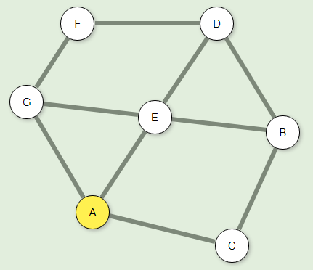
Activity
1.
Notes:
BFS
A C E G B D F

Slide 29
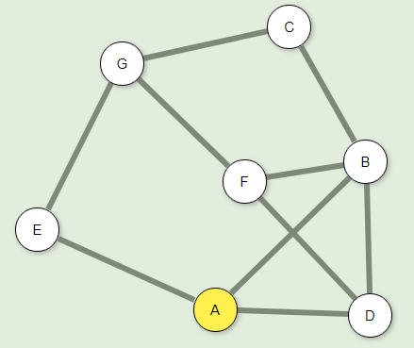
Activity
2.
Notes:
BFS
A B D E C F G

Slide 30
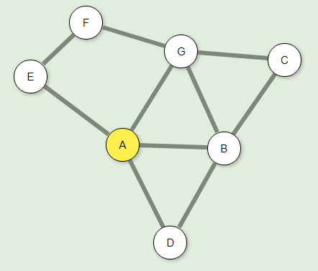
Activity
3.
Notes:
BFS
A B D E G C F

Slide 31
End of Presentation

